Slide 1

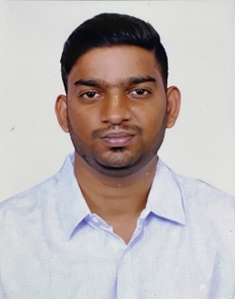


A Gautham Reddy
Education and certificates
Bachelor of Technology Electronics and Communication : 2018 - 2022
Analyst/Software Engineer
Skills Spring Boot Spring MVC
JPA CRUD/JPA MONGODB
Bootstrap
Base Location: Bangalore
Email ID:
gautham.reddy-a@capgemini.com
_{Mobile No: +91 9739392933}
Grade:
A4
Backend
Spring Boot/Spring Security MongoDB
REST-API
NodeJS
Strengths
A self driven learner with Front-End and Back-End knowledge. Passionate about implementing and launching new projects.
Ready to learn new technologies/Frameworks and implement them to further improve my knowledge.
A team player with good communication skill always ready to work for the enrichment of knowledge.
Has working knowledge on React and Java Microservice Development using Spring framework on an intermediate level.
Achivement
Deals and Coupon Application
Completed end to end case study of Deals and coupons application along with JWT authentication, Swagger and Billing System using Spring boot Microservices with Eureka Server. React JS used for user interface.
Database
SQL database – MySQL
No SQL database – MongoDB
Web Technologies
HTML5 CSS3
Javascript/TypeScript
Coded and designed Static Web Pages
Developed website with HTML5 and CSS3 Along Frameworks like SASS(Syntactically awesome style sheets) to make website more interactive and dynamic.
AddOns Github Maven Postman
Coded website for Resources used in Front-End
Development
Also Implemented Eureka Server in case study and upskilling day by day.
Designed and coded a website for the Resources used for making website like images,fonts,icons etc.
Additional Details
Excellent Communication Skills
Team Player
Presentation Title | Author | Date © Capgemini 2017. All rights reserved | 1

